Slide 1
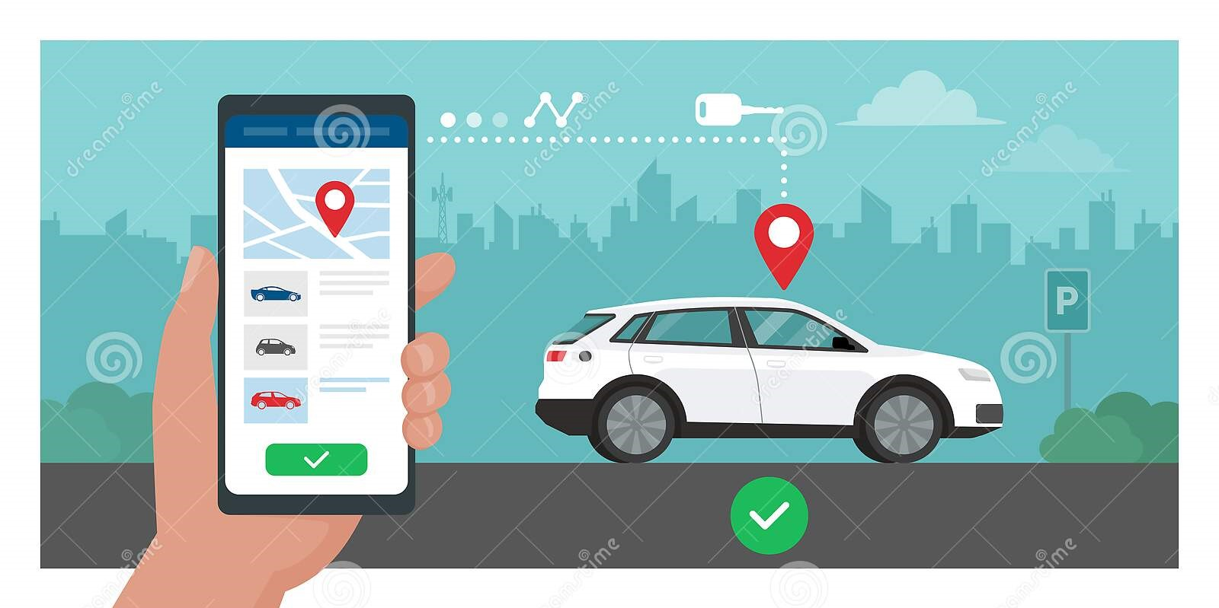

Vehicle Booking Application Database Design
by
P Hemanth Kumar Reddy
[ Batch_04 ]

Slide 2
Contents
Problem Statement
Abstract
Introduction
Objectives
ER Diagram
Implementation Summary
Results
Conclusion & Future Scope

Slide 3
Problem Statement
To design and test the database schema of an “Vehicle Booking System” that
provide services to of local , rental based on different types of vehicles such as
sedans, SUVs, mini-vans, and buses etc , for the customers on demand.
And the database schema should include the tables like “ users, customers,
drivers, admins, vehicles, bookings, payments, reviews etc ”

Slide 4
Abstract
The vehicle booking application database design provides a structured approach for
managing the “ bookings, vehicle , payments, reviews and ratings ”, on vehicle rentals.
The abstract of this database design outlines the various entities involved in the system,
including customers, admins, drivers, vehicles, booking details, and payment
information. The design includes normalized tables with proper relationships,
ensuring data integrity and efficient querying.
The database design aims to address the challenges of managing a vehicle booking
system, including managing a vast number of booking requests, assigning drivers
and vehicles, tracking payments and driver performance, and generating reports.
The database design provides a comprehensive and flexible solution that can be
easily extended to accommodate changing business requirements.

Slide 5
Introduction
The “vehicle booking application” database design is an efficient and
comprehensive solution for managing vehicle bookings and their associated data.
The system is designed to meet the needs of vehicle rental companies, allowing
them to manage and monitor their data of vehicles, bookings, and customers. This
database design provides a flexible solution to manage and track all the necessary
information related to vehicle bookings, customers, and vehicles. By using this kind
of database, vehicle rental companies can streamline their booking processes, reduce
errors, and enhance customer satisfaction. This presentation is an detailed overview
of the database design, its features, and functionalities.

Slide 6
Objectives
To create a centralized database for storing customer, driver, vehicle,
and booking information.
To enable customers to search for and book vehicles based on their
preferences and requirements.
To maintain data integrity by enforcing data constraints and validating input.
To provide flexibility to accommodate future changes and additions to the system.
To increase customer satisfaction by providing timely and accurate information on booking status and vehicle availability.

Slide 7
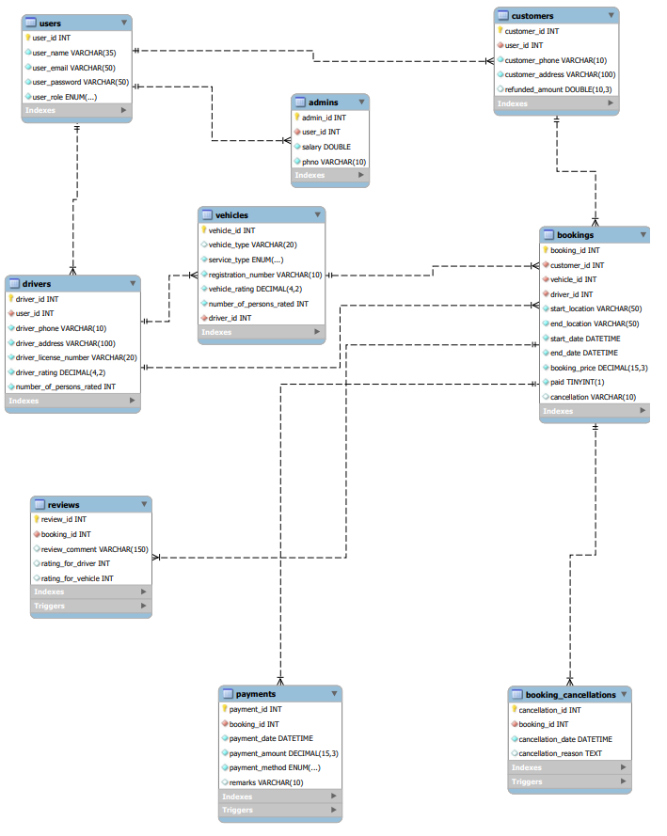
ER Diagram

Slide 8
Implementation Summary
The implementation of database schema includes the following sub sections
Creation of Tables
Imposing constraints for data integrity
Integrating tables ( establishing relationships )
Sample tables data
Triggers

Slide 9
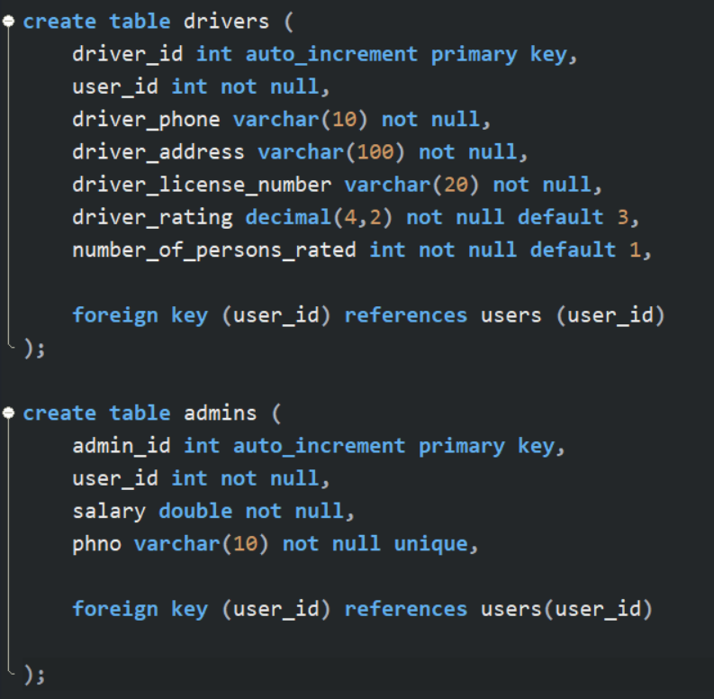
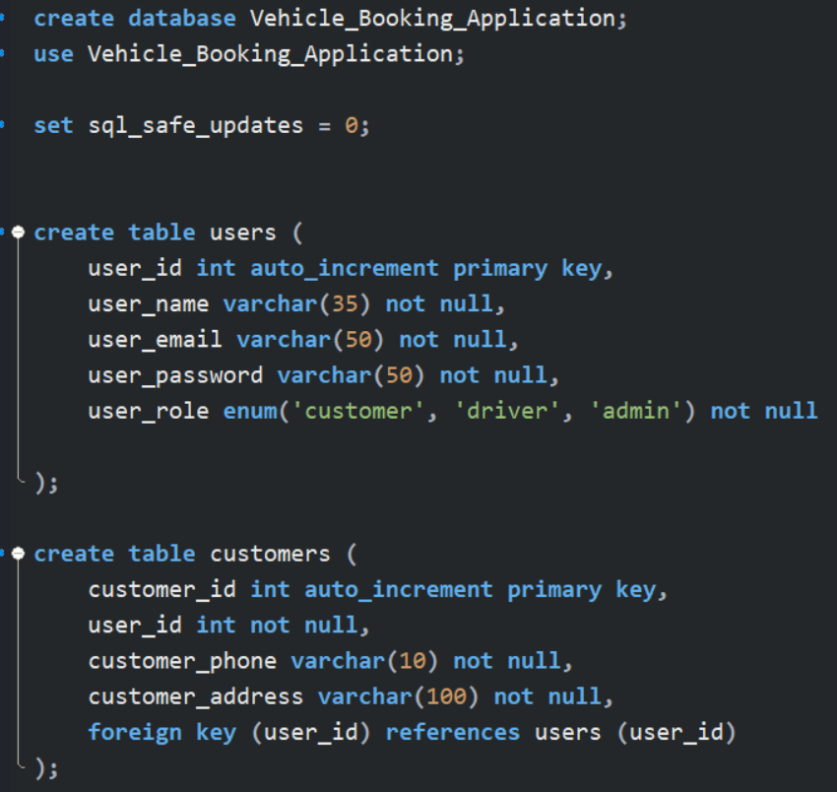
Creation of Tables

Slide 10
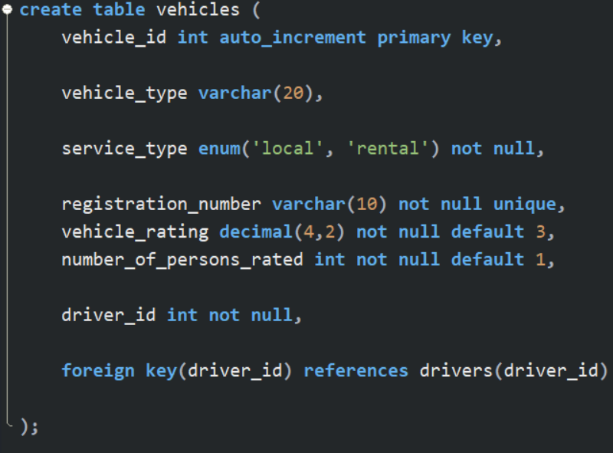
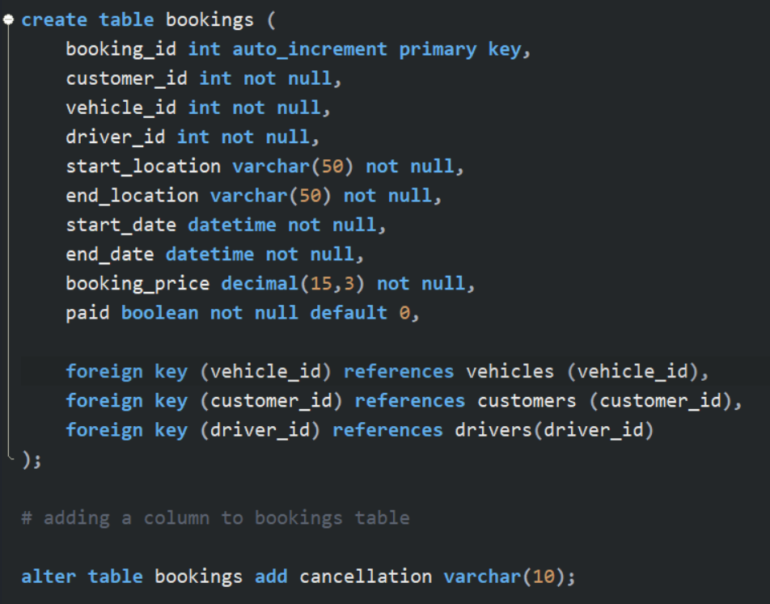
Continued ……

Slide 11
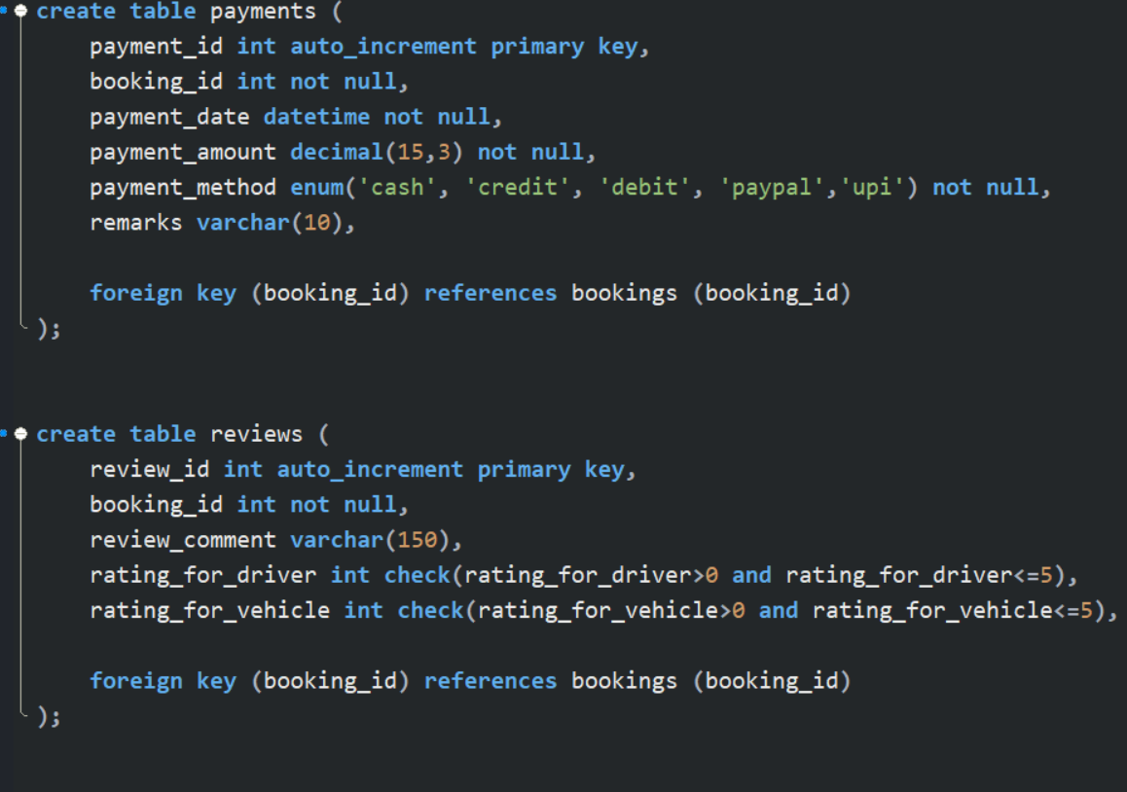
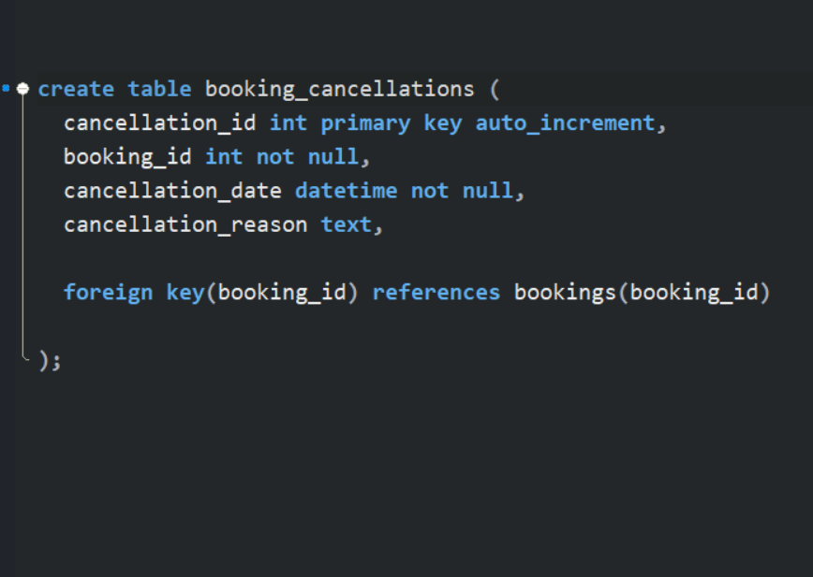
Continued ……..

Slide 12
Imposing constraints for data integrity
Constraints like NOT NULL, PRIMARY KEY, CHECK,UNIQUE are used in the database
Schema design to enforce data integrity rules and prevent invalid data from being inserted or updated.
Integrating Tables
As per the business requirement the various tables in the database are integrated by
using the “FOREIGN KEY”

Slide 13
Triggers
Triggers are stored programs that are automatically executed in response to specific events or actions that occur on a table.
In this database design 3 triggers are included:-
Trigger to update the ratings of vehicle and driver
Trigger to update the payment status of the booked vehicle
Trigger to cancel the booked vehicle and refund the payment
once the user cancelled the booking.

Slide 14
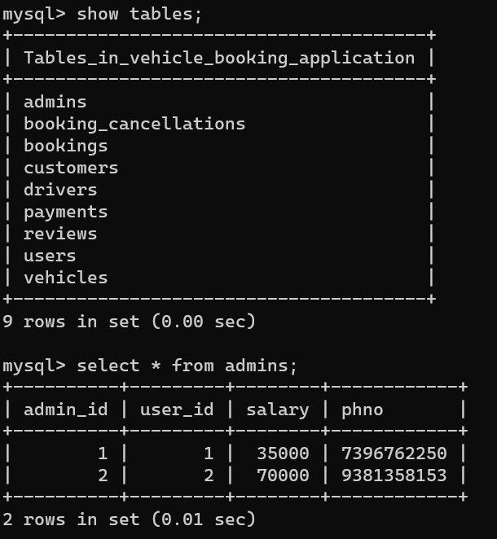
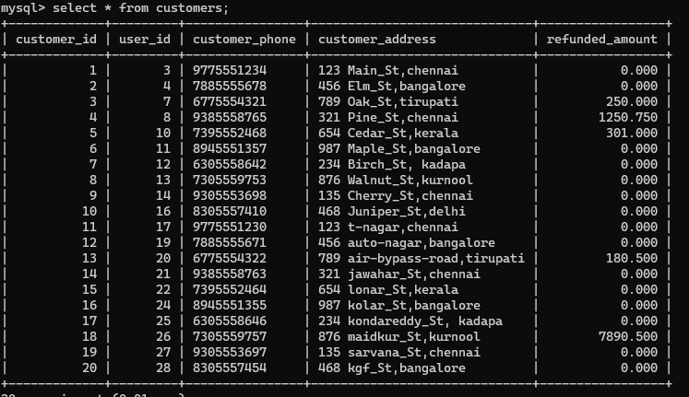
Sample Tables data

Slide 15
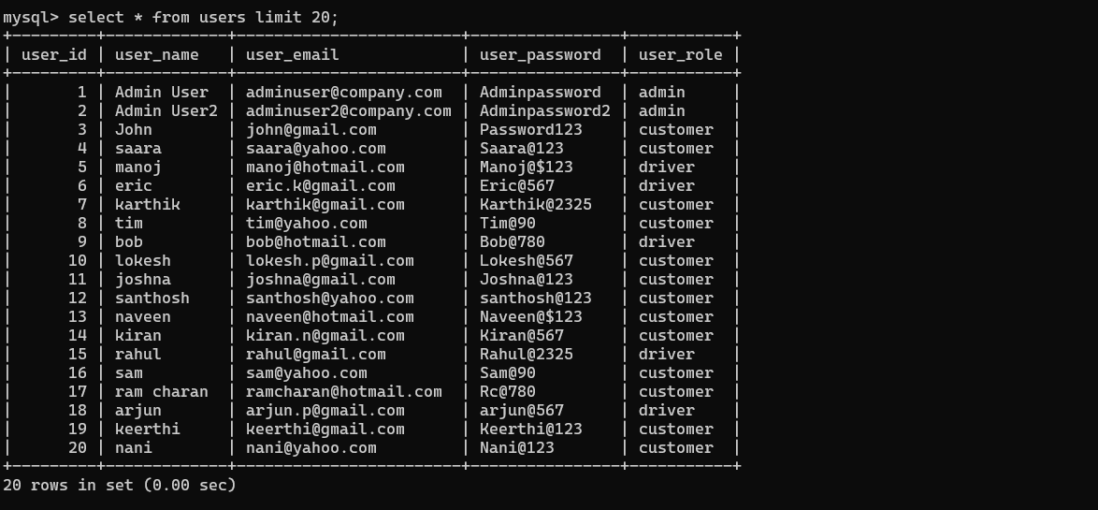
Continued ….

Slide 16
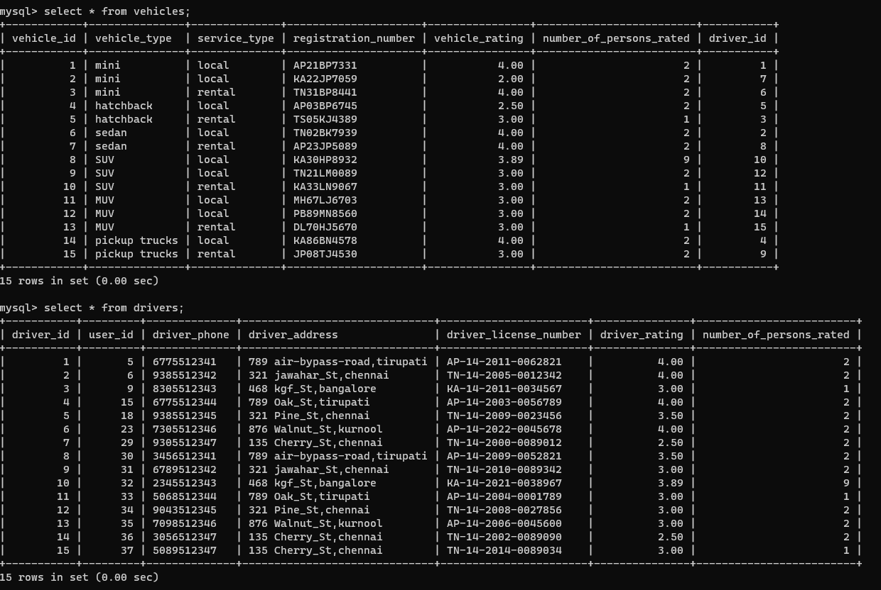
Continued ….

Slide 17
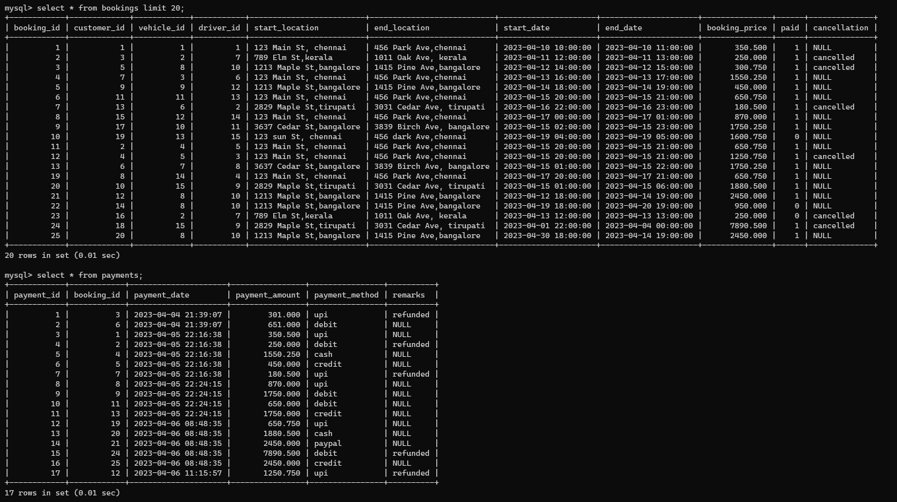
Continued ….

Slide 18
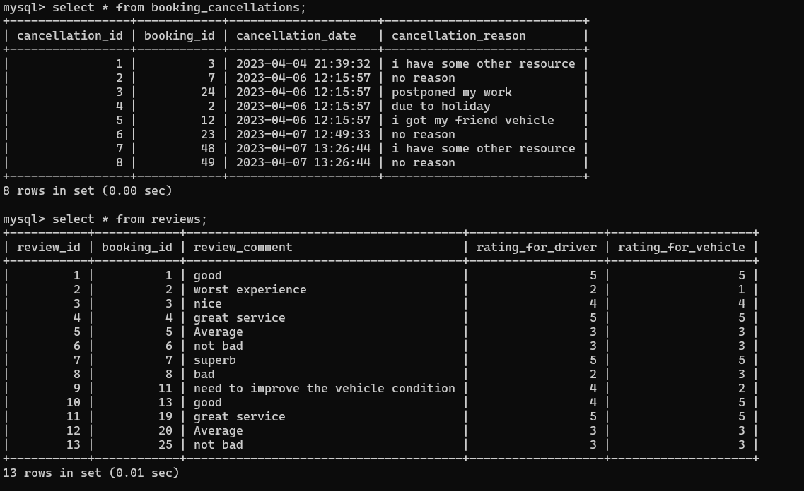
Continued ….

Slide 19
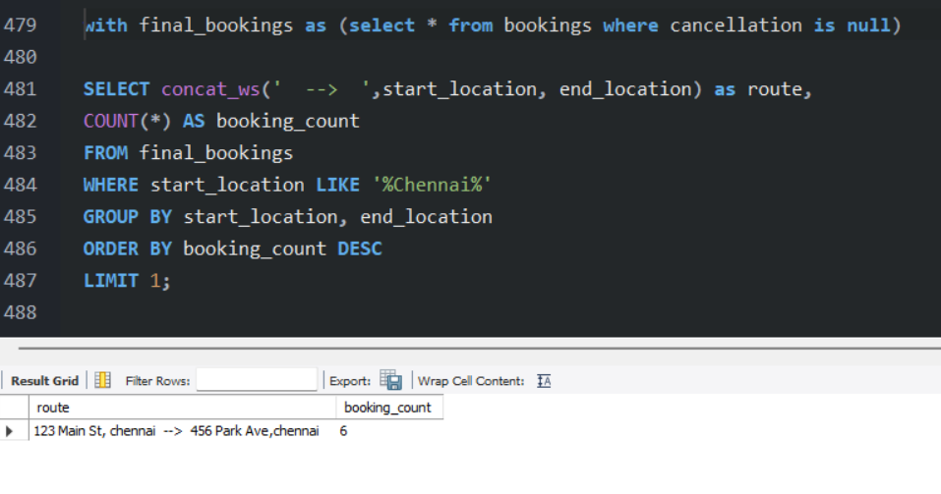
Results
Query 1
Populate the data and display the most frequently Booked Route in Chennai.
Output

Slide 20
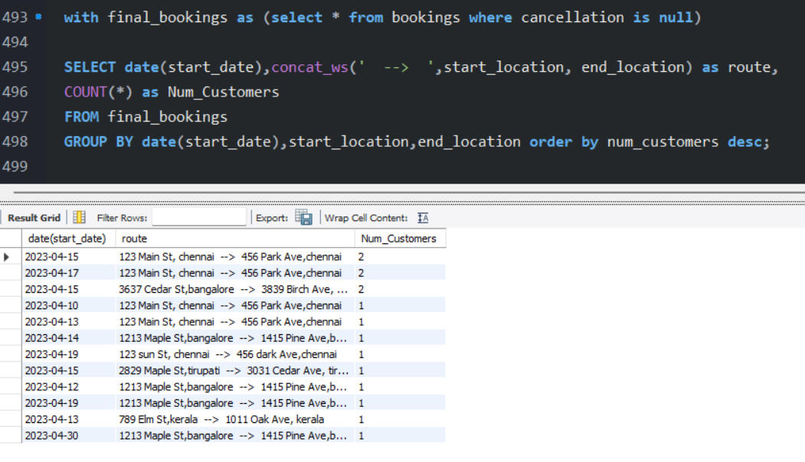
Query 2
Display the Number of Customers who travelled in "each date and in each Route".
Output

Slide 21
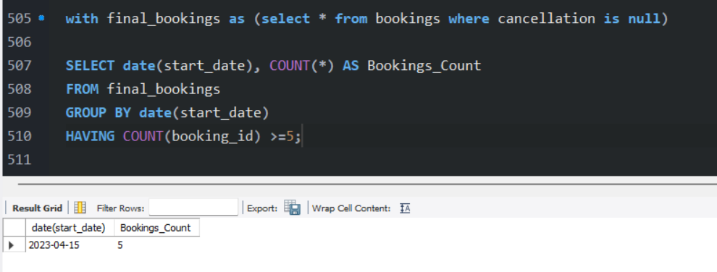
Query 3
Display the Bookings count is >=5 in each Day.
Output

Slide 22
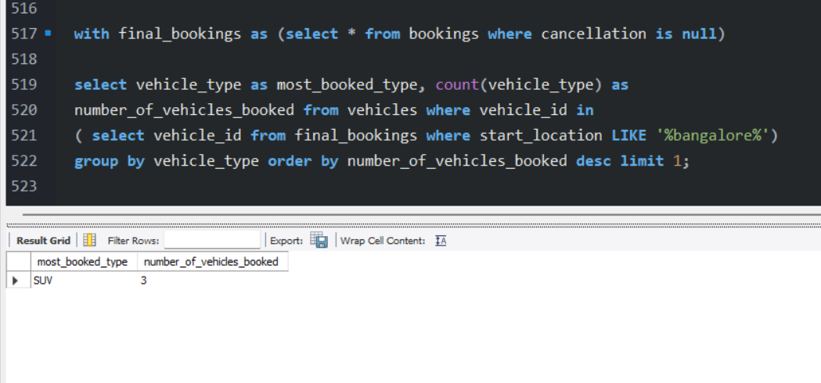
Query 4
List out most booked type of Vehicle (SUV, Mini etc.,) in Bangalore City
Output

Slide 23
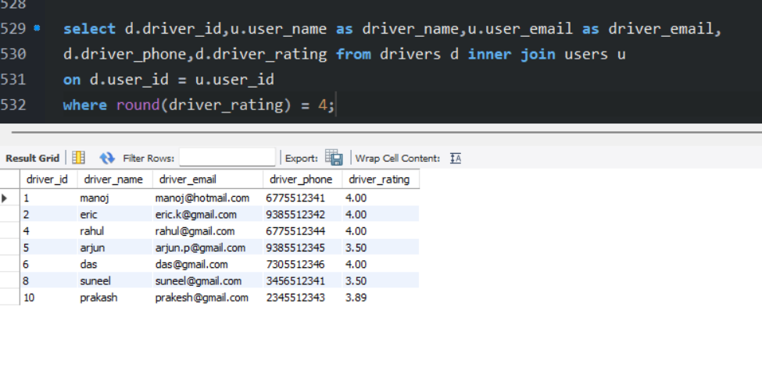
Query 5
Display the 4 star rated driver details to initiate incentives by Company.
Output

Slide 24
Conclusion
“vehicle booking application” database design has been designed to store all the
necessary information related to bookings, customers, vehicles, drivers, and
payments.
In conclusion, the database design is capable of efficiently handling of data,
ensuring data integrity and providing fast access to information. However, there is
always room for improvement and future scope to enhance the system's features
and functionalities.
In future we will try to include more optimized futures and functionalities .

Slide 25
Thank you

